Slide 1

Module II
Supervised Learning

Slide 2
Module Content
Supervised Learning
How Supervised Learning Work?
Steps Involved in Supervised Learning
Data Science Process
Types of Supervised Learning Algorithms
Merits and Demerits of Supervised Learning Algorithms
Linear Regression & Multiple Linear Regression
Logistic Regression
K-Nearest Neighbour
Bayesian Decision Theory (Naïve Bayes)
Neural Networks (LNN, MLP)
Support Vector Machine
Decision Trees

Slide 3
Supervised Learning
Supervised learning is the types of machine learning in which machines are trained using well "labelled" training data, and on basis of that data, machines predict the output.
The labelled data means some input data is already tagged with the correct output.
In supervised learning, the training data provided to the machines work as the supervisor that teaches the machines to predict the output correctly.
Supervised learning is a process of providing input data as well as correct output data to the machine learning model.

Slide 4
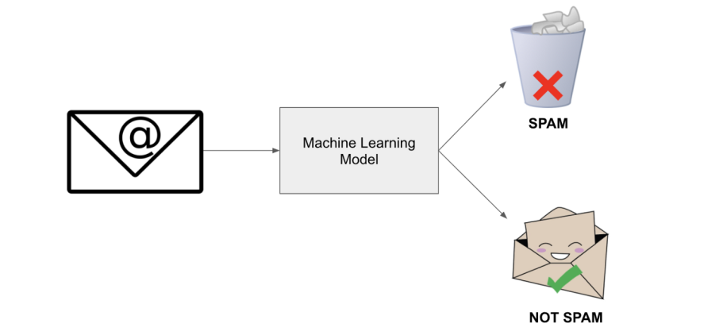
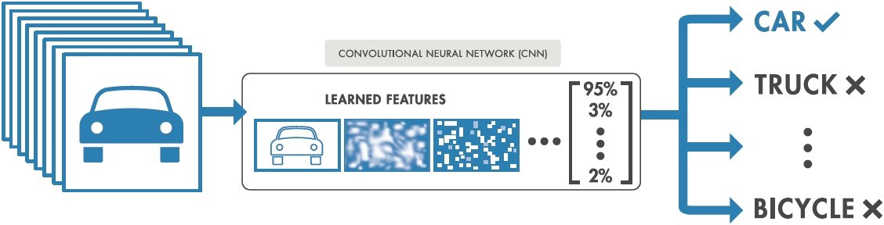
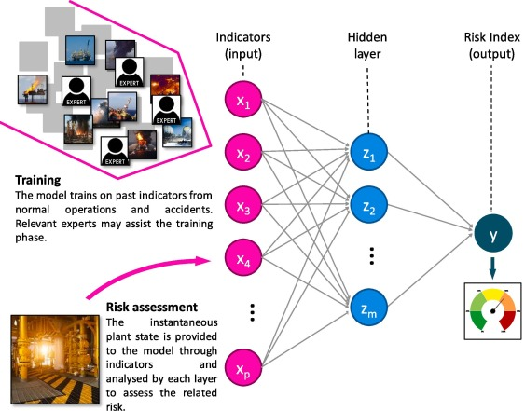
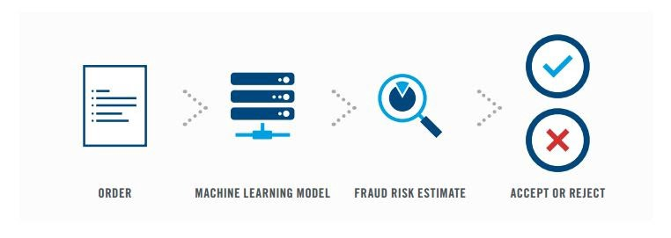
Supervised Learning
In the real-world, supervised learning can be used for
Spam filtering
Image classification
Risk Assessment
Fraud Detection

Slide 5
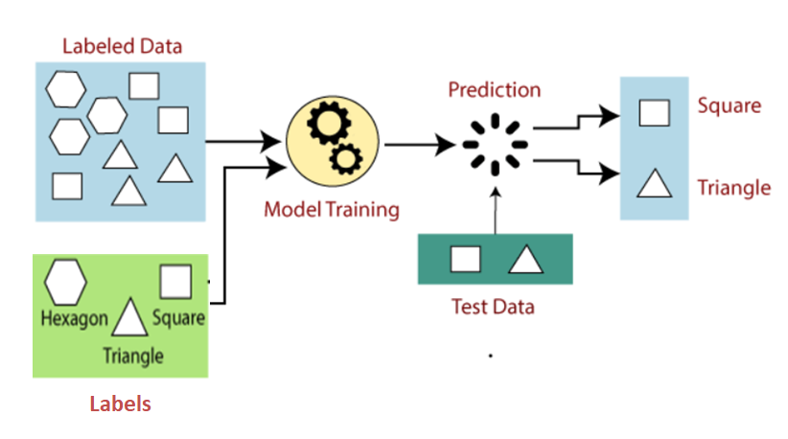
How Supervised Learning Works?

Slide 6
Steps Involved in Supervised Learning
First determine the type of training dataset
Collect/gather the labelled training data.
Split the training dataset into training dataset, test dataset, and validation dataset.
Determine the input features of the training dataset, which should have enough knowledge so that the model can accurately predict the output.
Determine the suitable algorithm for the model, such as support vector machine, decision tree, etc.
Execute the algorithm on the training dataset. Sometimes we need validation sets as the control parameters, which are the subset of training datasets.
Evaluate the accuracy of the model by providing the test set. If the model predicts the correct output, which means our model is accurate.

Slide 7
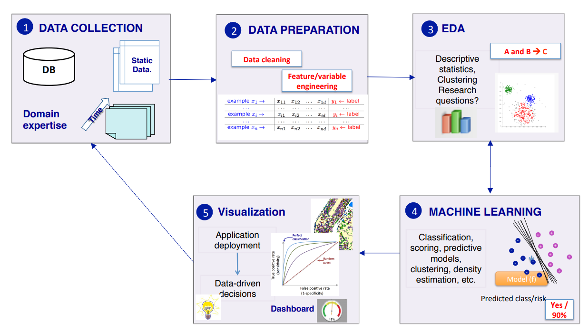
Data Science Process

Slide 8
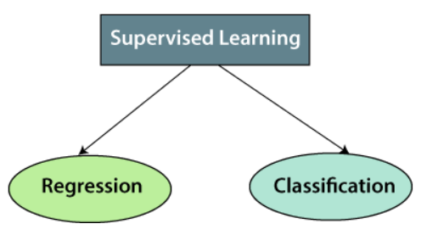
Types of Supervised Learning Algorithms
Supervised learning can be divided into two types of problems:

Slide 9
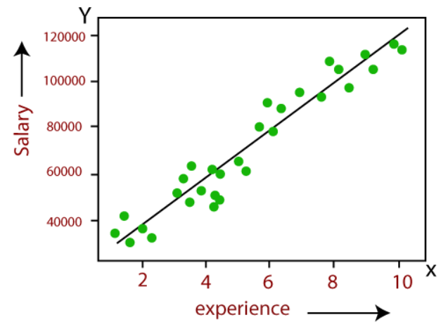
Types of Supervised Learning Algorithms
Regression
Regression algorithms are used to model a relationship between the independent variable and the dependent variable.
It is used for the prediction of continuous variables: weather forecasting, market trends, salary forecasting, real estate prediction, prediction of road accidents due to rash driving, etc.

Slide 10
Terminologies
Dependent Variable: The main factor in Regression analysis which we want to predict or understand is called the dependent variable. It is also called target variable (Y).
Independent Variable: The factors which affect the dependent variables or which are used to predict the values of the dependent variables are called independent variable (X), also called as a predictor.
Outliers: Outlier is an observation which contains either very low value or very high value in comparison to other observed values. An outlier may hamper the result, so it should be avoided.
Underfitting and Overfitting: If our algorithm works well with the training dataset but not well with test dataset, then such problem is called Overfitting. And if our algorithm does not perform well even with training dataset, then such problem is called Underfitting.

Slide 11
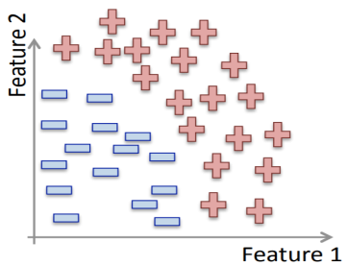
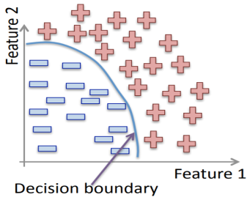
Types of Supervised Learning Algorithms
Classification
Classification algorithms are used when the output variable is categorical;
Binary classification classify two classes such as Yes-No, Male-Female, True-False, etc. Example: Spam Filtering.
Multi-classification classify more than two classes, etc. Example: to predict each image label in a dataset containing dog, cat, and goat.
Below are some popular Classification algorithms which come under supervised learning:
Logistic Regression
Support vector Machines
Decision Trees
Random Forest

Slide 12
Merit of Supervised learning
With the help of supervised learning, the model can predict the output on the basis of prior experiences.
In supervised learning, we can have an exact idea about the classes of objects.
Supervised learning model helps us to solve various real-world problems such as fraud detection, spam filtering, etc.

Slide 13
Demerit of Supervised learning
Supervised learning models are not suitable for handling the complex tasks.
Supervised learning cannot predict the correct output if the test data is different from the training dataset.
In supervised learning, we need enough knowledge about the classes of object.

Slide 14
Regression
Regression is a supervised learning technique which helps in finding the correlation between variables and enables us to predict the continuous output variable based on the one or more predictor variables.
It is mainly used for prediction, forecasting, and time series modeling
"Regression shows a line or curve that passes through all the data-points on target-predictor graph in such a way that the vertical distance between the data-points and the regression line is minimum.“

Slide 15
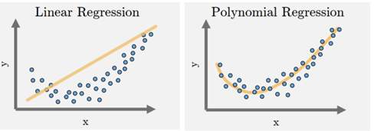
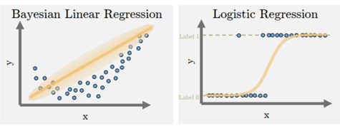
Visualize Types of Regression

Slide 16
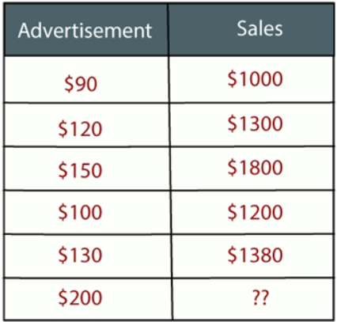
Example: Regression Task
Suppose there is a marketing company A, who does various advertisement every year and get sales on that. The below list shows the advertisement made by the company in the last 5 years and the corresponding sales:
Now, the company wants to do the advertisement of $200 in the year 2022 and wants to know the prediction about the sales for this year. So to solve such type of prediction problems in machine learning, we need regression analysis.

Slide 17
Why do we use Regression Analysis?
Regression estimates the relationship between the target (dependent variable) and the independent variable.
It is used to find the trends in data.
It helps to predict real/continuous values.
By performing the regression, we can confidently determine the most important factor, the least important factor, and how each factor is affecting the other factors.

Slide 18
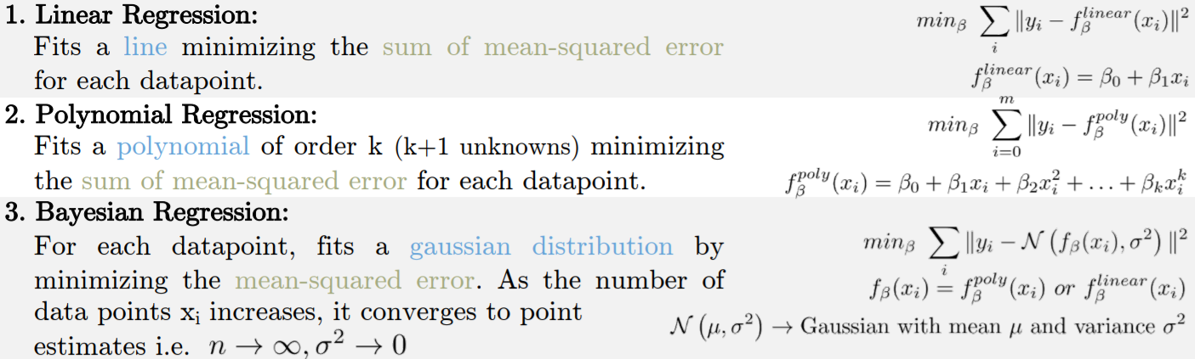
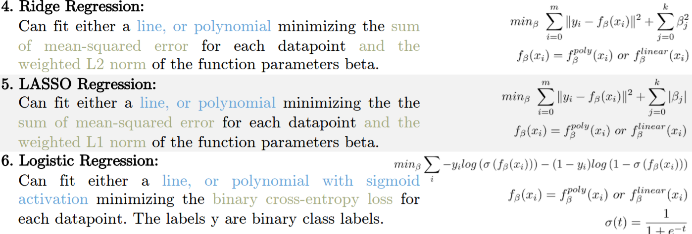
Types of Regression

Slide 19
Linear Regression

Slide 20
Linear Regression
Linear regression is one of the easiest and most popular Machine Learning algorithms.
Linear regression shows the linear relationship between the independent variable (X-axis) and the dependent variable (Y-axis), hence called linear regression.
Example: Here we are predicting the salary of an employee on the basis of the year of experience.
Y= aX+b
Where;
Y = dependent variables (target variables); X= Independent variables (predictor variables); a and b are the linear coefficients

Slide 21
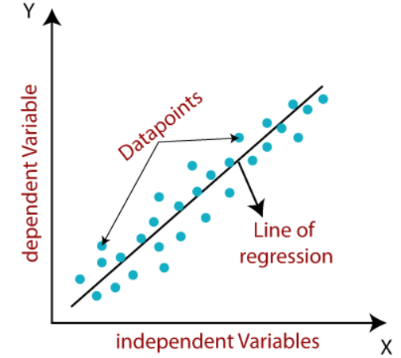
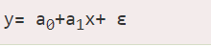
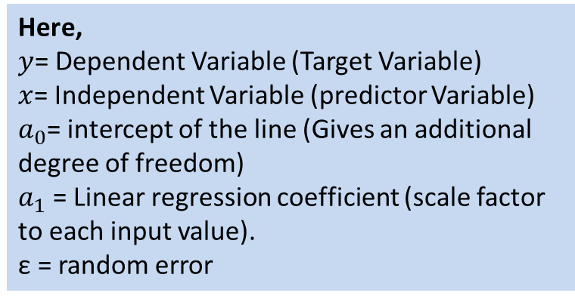
Linear Regression
Mathematically, we can represent a linear regression as:
Here,
$y$= Dependent Variable (Target Variable) $x$= Independent Variable (predictor Variable) $a_{0}$= intercept of the line (Gives an additional degree of freedom) $a_{1}$ = Linear regression coefficient (scale factor to each input value). ε = random error
The values for x and y variables are training datasets for Linear Regression model representation.

Slide 22
Types of Linear Regression
Linear regression can be divided into two types of the algorithm:
Simple Linear Regression: If a single independent variable is used to predict the value of a numerical dependent variable, then such a Linear Regression algorithm is called Simple Linear Regression.
Multiple Linear regression: If more than one independent variable is used to predict the value of a numerical dependent variable, then such a Linear Regression algorithm is called Multiple Linear Regression.

Slide 23
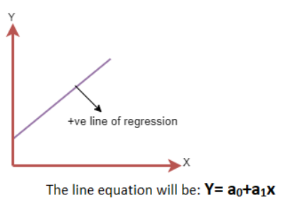
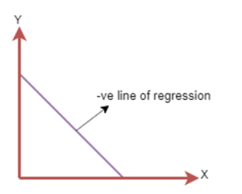
Linear Regression Line
Positive Linear Relationship
If the dependent variable increases on the Y-axis and independent variable increases on X-axis, then such a relationship is termed as a Positive Linear Relationship.
Negative Linear Relationship
If the dependent variable decreases on the Y-axis and independent variable increases on the X-axis, then such a relationship is called a Negative Linear Relationship.
This line of equation will be: $Y= a_{0}− a_{1} x$

Slide 24
Finding the best fit line
When working with linear regression, our main goal is to find the best fit line that means the error between predicted values and actual values should be minimized.
The best fit line will have the least error.
The different values for weights or the coefficient of lines (a₀, a₁) gives a different line of regression:
so we need to calculate the best values for a₀ and a₁ to find the best fit line, so to calculate this we use cost function.

Slide 25
Housing Prices
(Portland, OR)
Price
(in 1000s of dollars)
Size (feet²)
Supervised Learning
Given the “right answer” for each example in the data.
Regression Problem
Predict real-valued output

Slide 26
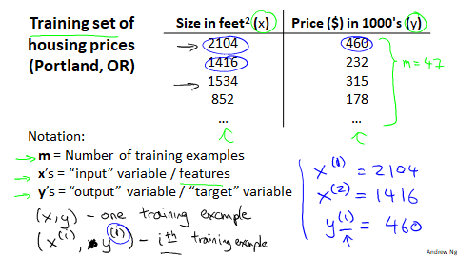

Slide 27
Training Set
How do we represent h ?
Learning Algorithm
Size of house
h
Estimated price
Linear regression with one variable.
Univariate linear regression.

Slide 28
Cost function
Linear regression with one variable

Slide 29
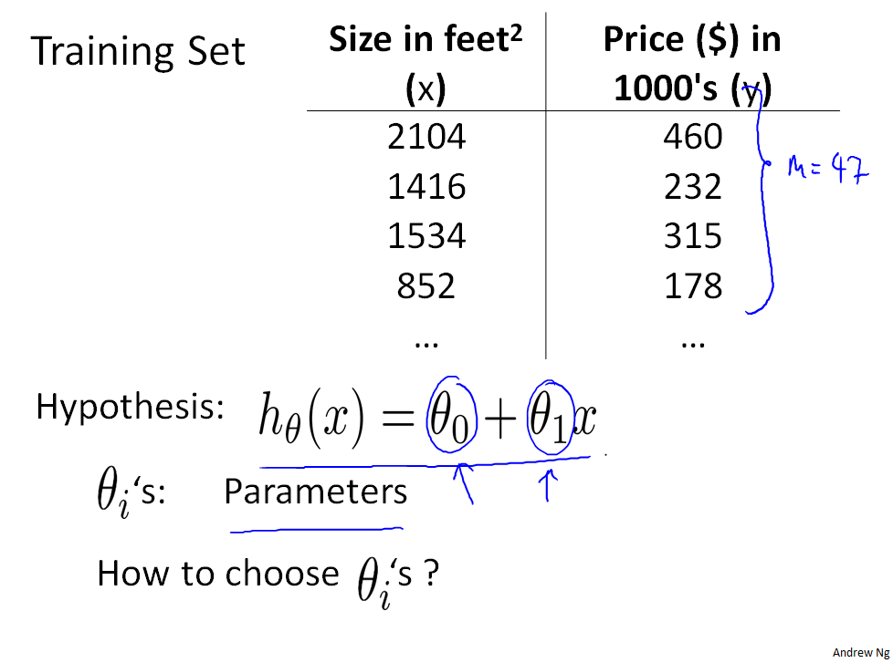

Slide 30

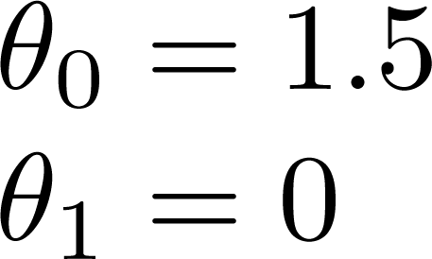
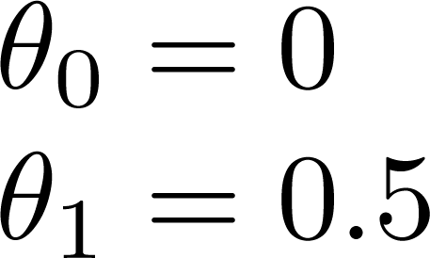
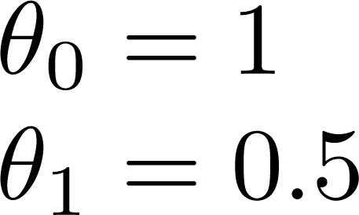

Slide 31
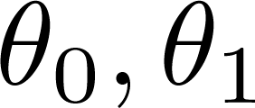
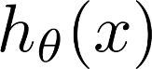

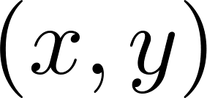
y
x
Idea: Choose so that is close to for our training examples

Slide 32
Cost function intuition I
Linear regression with one variable
Machine Learning

Slide 33
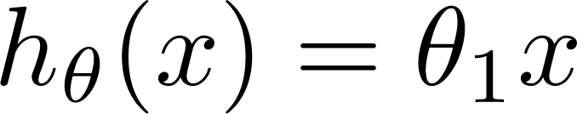
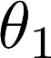
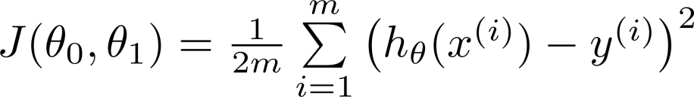
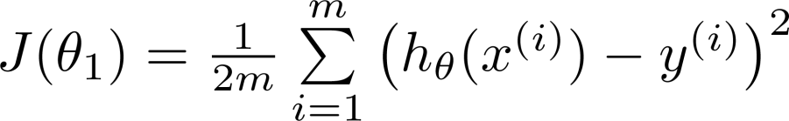
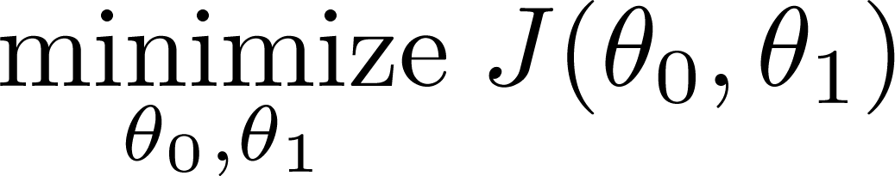
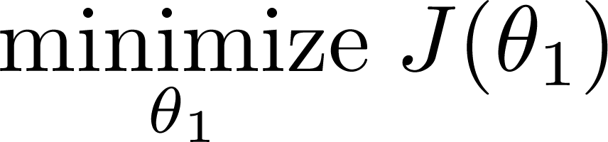
Simplified
Hypothesis:
Parameters:
Cost Function:
Goal:

Slide 34
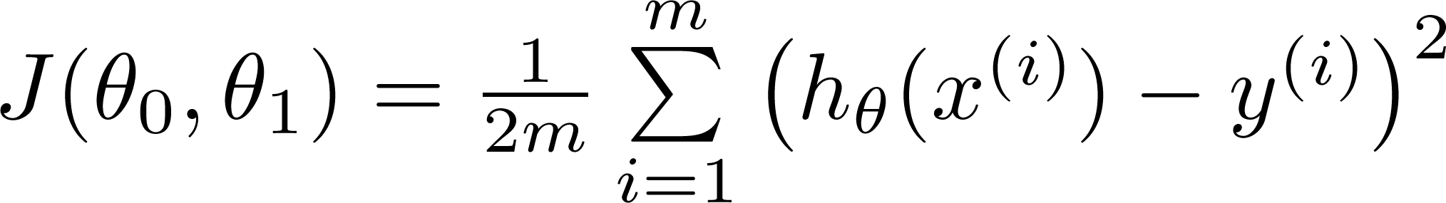
Hypothesis:
Parameters:
Cost Function:
Goal:

Slide 35
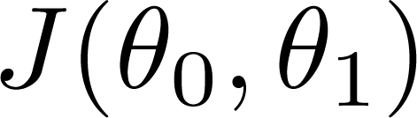
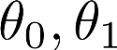
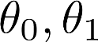
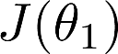
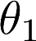
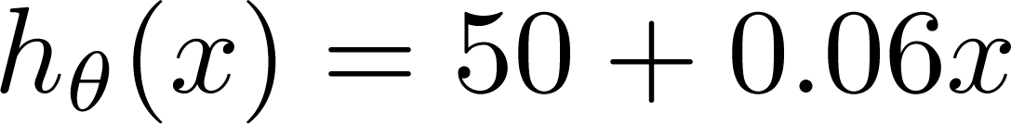
(for fixed , this is a function of x)
(function of the parameters )
Price ($)
in 1000’s
Size in feet² (x)

Slide 36
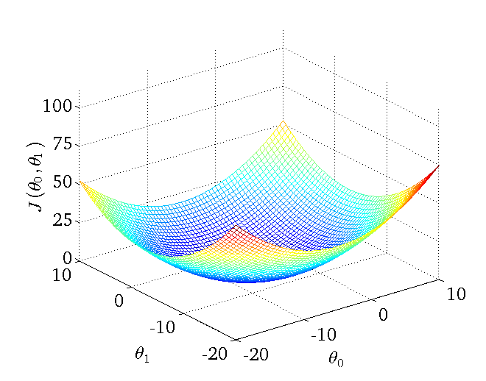

Slide 37
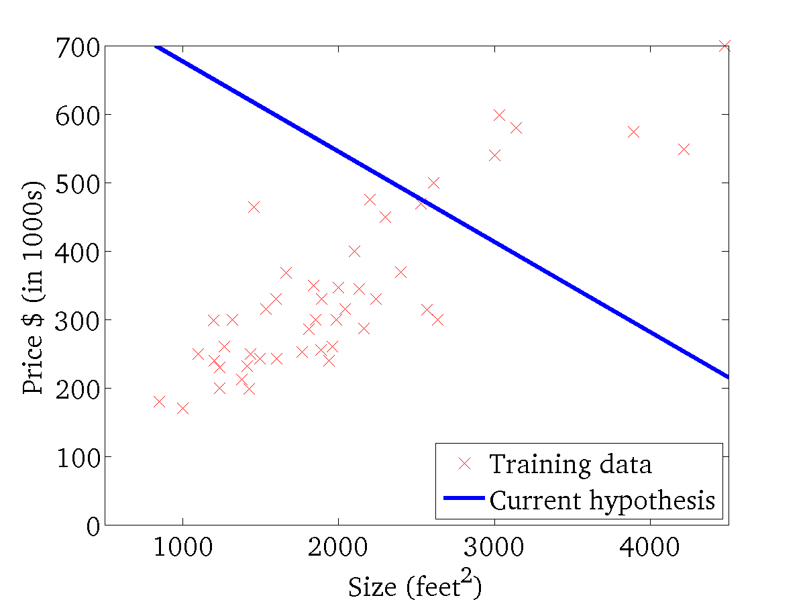
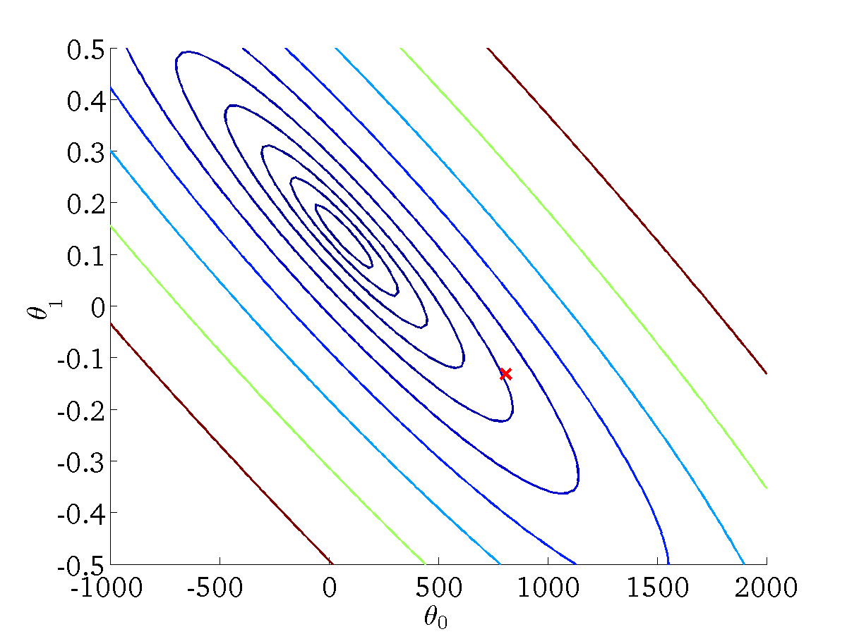
(for fixed , this is a function of x)
(function of the parameters )

Slide 38
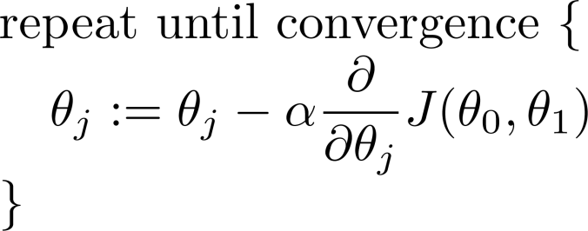
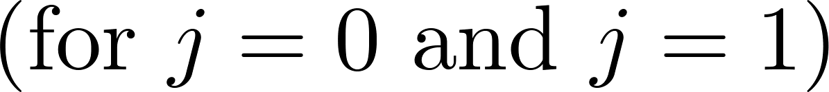
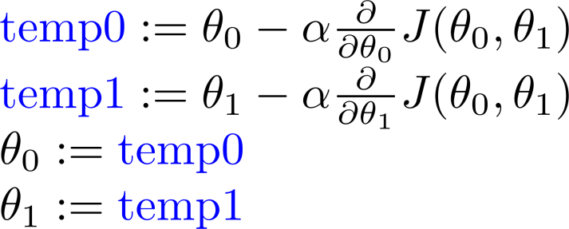
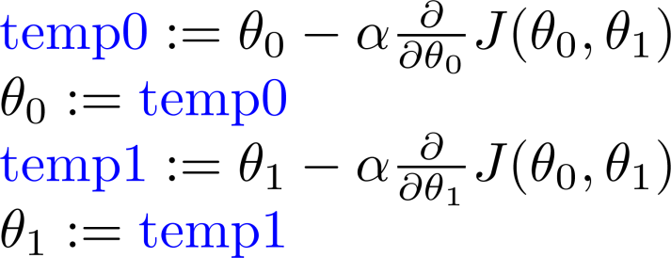
Gradient descent algorithm
Correct: Simultaneous update
Incorrect:

Slide 39
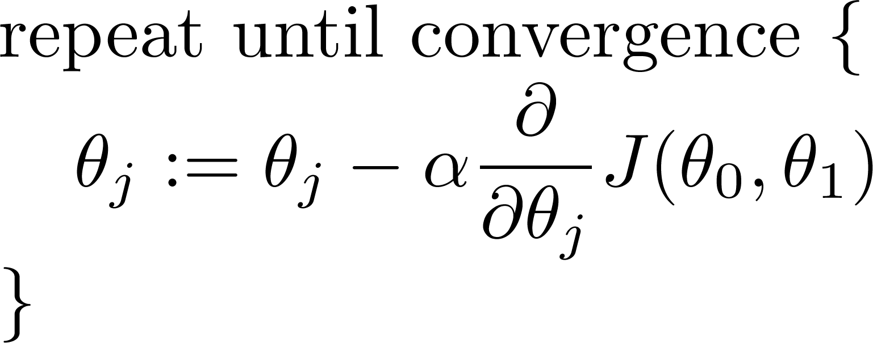
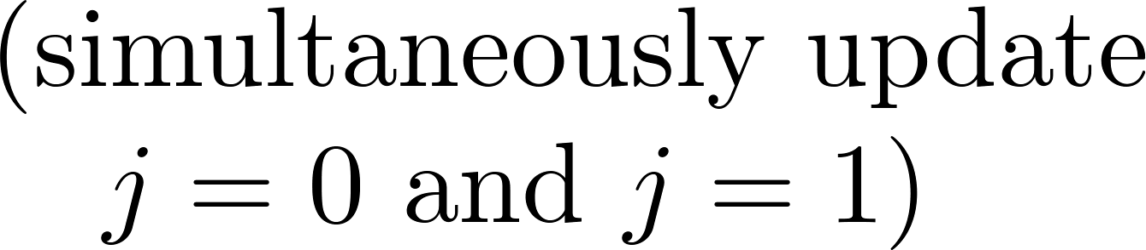
Gradient descent algorithm

Slide 41

If α is too small, gradient descent can be slow.
If α is too large, gradient descent can overshoot the minimum. It may fail to converge, or even diverge.

Slide 42


at local optima
Current value of

Slide 43


Gradient descent algorithm
Linear Regression Model

Slide 44




Slide 45


Gradient descent algorithm
update
and
simultaneously

Slide 46

J(θ₀,θ₁)
θ₁
θ₀

Slide 47
J(θ₀,θ₁)
θ₁
θ₀

Slide 48


(for fixed , this is a function of x)
(function of the parameters )

Slide 49

(for fixed , this is a function of x)
(function of the parameters )

Slide 50


(for fixed , this is a function of x)
(function of the parameters )

Slide 51


(for fixed , this is a function of x)
(function of the parameters )

Slide 52


(for fixed , this is a function of x)
(function of the parameters )

Slide 53


(for fixed , this is a function of x)
(function of the parameters )

Slide 54


(for fixed , this is a function of x)
(function of the parameters )

Slide 55


(for fixed , this is a function of x)
(function of the parameters )

Slide 56


(for fixed , this is a function of x)
(function of the parameters )

Slide 57
PRACTICAL LAB
Years Experience | Salary
1.1 | 39343
1.3 | 46205
1.5 | 37731
2 | 43525
2.2 | 39891
2.9 | 56642
3 | 60150
3.2 | 54445
3.2 | 64445
3.7 | 57189
3.9 | 63218
4 | 55794
4 | 56957
4.1 | 57081
4.5 | 61111
4.9 | 67938
5.1 | 66029
5.3 | 83088
5.9 | 81363
6 | 93940
6.8 | 91738
7.1 | 98273
7.9 | 101302
8.2 | 113812
8.7 | 109431
9 | 105582
9.5 | 116969
9.6 | 112635
10.3 | 122391
10.5 | 121872
Given a Salary Dataset, If a person has 2.5 years experience in an Oil & Gas sector, use linear regression to estimate the salary of such a person?
Hint: All program should be written in python programming language

Slide 58


Linear Regression with Gradient Descent Algorithm

Slide 59

Multiple Linear Regression
Multiple Linear Regression is one of the important regression algorithms which models the linear relationship between a single dependent continuous variable and more than one independent variable.

Slide 60


Multiple Linear Regression

Slide 61

Regression

Slide 62
Regression: From LogL to Error

Slide 63
Linear Regression

Slide 64

Polynomial Regression
Polynomial Regression is a regression algorithm that models the relationship between a dependent(y) and independent variable(x) as n^{th) degree polynomial. The Polynomial Regression equation is given below:

Slide 65
Polynomial Regression

Slide 66
Polynomial Regression

Slide 67



Regression Evaluation Metrics

